Slide 1

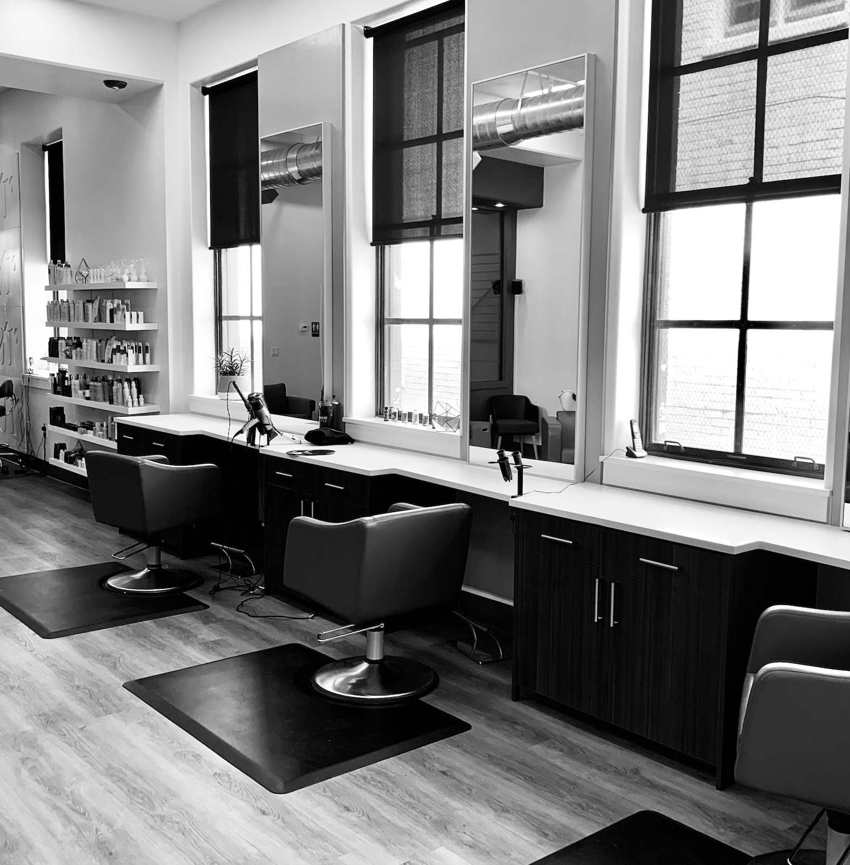
TONSORIUM
TWITS
ALL SALONS UNDER ONE ROOF

Slide 2

CONTENT
01
OUR TEAM
02
COMPANY INTRODUCTION
03
PROJECT INTRODUCTION
04
REQUIREMENT AND GATHERING
05
EXISTING SYSTEM
06
PROPOSED SYSTEM
07
TOOLS AND TECHNOLOGY
08
DFD

Slide 3


OUR TEAM

Slide 4



ST. XAVIER’S COLLEGE, AHMEDABAD
GROUP 8
KRISHNA HANDA
21-BCA-025
NAYAN PATIDAR 21-BCA-056
NIHAR SHAH 21-BCA-070
INTERNAL GUIDE : Ms. KHUSHBOO SHAH
EXTERNAL GUIDE : Mr. PALLAV MAMTORA (TECHMICRA IT SOLUTIONS)
CO-ORDINATORS :
Mr. DHWANIR SHAH
Dr. MANALI BRAHMBHATT

Slide 5

COMPANY INTRODUCTION

Slide 6





COMPANY INTRODUCTION
Techmicra IT Solutions based in Ahmedabad have been providing IT solutions & services to organizations
since 2013 located at Office No 12. First Floor Sanidhya Building, Ashram Rd, opp. UCO Bank, Ellisbridge,
Ahmedabad, Gujarat 380006
Contact Person: Pallav Mamtora Contact No. 9727835207.
The company started with web development and design solutions during its inception phase and now has more than 25 departments like CRM development, Branding solutions, ERP implementation solutions, database administration & development, business intelligence and data analytics and more. With over 40 plus employees we are continually growing in each and every technology/domain. Extensive training and research programs for all our trainers and developers strengthen our grip and make us better in what we do.

Slide 7
PROJECT DEFINITION

Slide 8


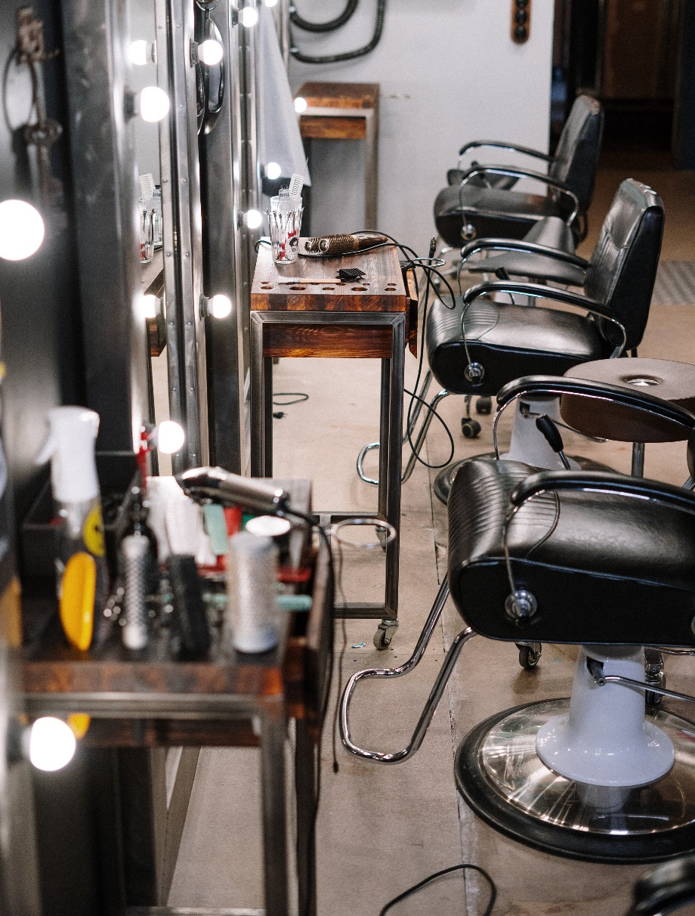
PROJECT DEFINITION
Tonsorium (Latin) is a location where a skilled barber offers services.
Tonsorium Twits will be a web-based application which is used for the unisex Tonsorium.
This system will manage the day-to-day tasks of the Tonsorium related to it’s Admin, Customer and Staff Members.
Customer can choose among multiple tonsoriums across City and manage Appointments online.
Maintains the clients, offers, employees and accounts which include the bills, expenses etc.

Slide 9
REQUIREMENT GATHERING

Slide 10

REQUIREMENT GATHERING
There are 5 entities in our System:
ADMIN
VISITOR
TONSORIUM OWNER
TONSORIUM STAFF
CUSTOMER

Slide 11

REQUIREMENT GATHERING
ADMIN
ADMIN CAN :
Login using login credentials
Manage Tonsorium Owners (Approve Tonsorium and De-Activate Tonsorium)
Manage Customers (Approve and De-Activate)
Manage Services (Add, Update and Remove Services)
Manage Payments(Make Payment to Tonsorium Owners, Receive payment from Customers, Refund, etc.)
View Feedback From Customers

Slide 12

REQUIREMENT GATHERING
VISITOR
VISITOR CAN:
View Tonsoriums
View Services
Signup by providing relevant details
View feedbacks of Tonsoriums and Staff

Slide 13

REQUIREMENT GATHERING
TONSORIUM OWNER
TONSORIUM OWNER CAN:
Sign up by providing relevant details
Login using login credentials
Manage Services (Add, Update, Remove Services)
Manage Appointments (Cancel Appointments)
Manage Staff (Add staff, Update staff details, Remove staff, etc)
Manage Payments (View)
View feedback from Customers

Slide 14

REQUIREMENT GATHERING
TONSORIUM STAFF:
STAFF CAN:
Login using login credentials
Manage Appointments (Accept/Decline and Cancel)
View feedback from customers
View work details (Total Customers served, ratings, etc.)

Slide 15

REQUIREMENT GATHERING
CUSTOMER:
CUSTOMER CAN:
Login using login credentials
View Tonsorium and Services
Manage Appointments (Book, Cancel and Reschedule)
Make payments and request refund
View and provide rating and feedback to Tonsorium and Staff

Slide 16
EXISTING
SYSTEM

Slide 17

EXISTING SYSTEM
Currently there are web-apps available online such as: https://www.miosalon.com/
https://respark.in/
https://www.tonsorium.co.uk/
This all systems provide services to only single tonsoriums at a time.

Slide 18
PROPOSED
SYSTEM

Slide 19
PROPOSED SYSTEM
All existing systems provide services to only single Tonsorium.
Our system provides platform to list down their Tonsorium’s online on our platform and customer can choose Tonsorium’s among multiple available options in their locations.
They can Book, Schedule, Reschedule their appointments online with convenience from their homes to save their precious time.
Also customer has option to choose Tonsoriums according to Ratings and Reviews in order to ensure that they get best services.

Slide 20
TOOLS AND TECHNOLOGY USED

Slide 21







TOOLS AND TECHNOLOGY USED
FRONT-END
BACK-END
OTHER TOOLS
MS PowerPoint 2021
Draw.io v21.6.1
Canva v1.38.0
HTML 5
CSS 3
JavaScript 13
REACT JS v18
mongoDB v6.0.7
Node JS v20

Slide 22
D F D
DATA FLOW DIAGRAMS

Slide 23
LEVEL 0

Slide 24
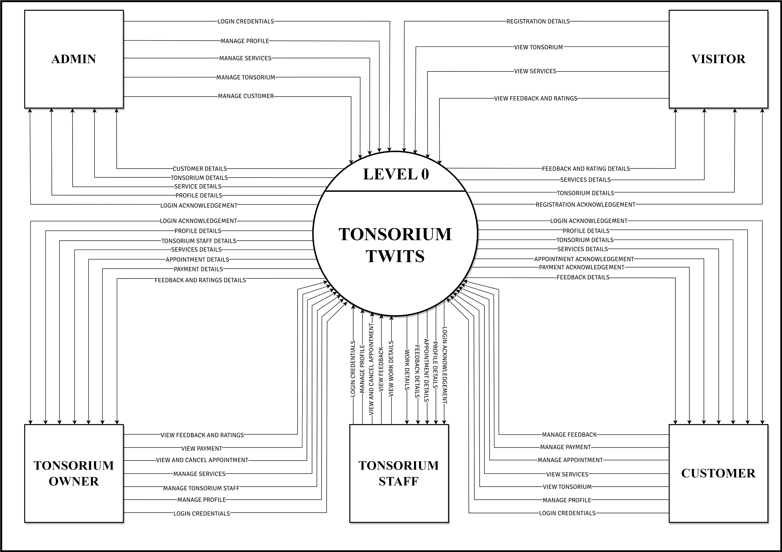

Slide 25
LEVEL 1

Slide 26
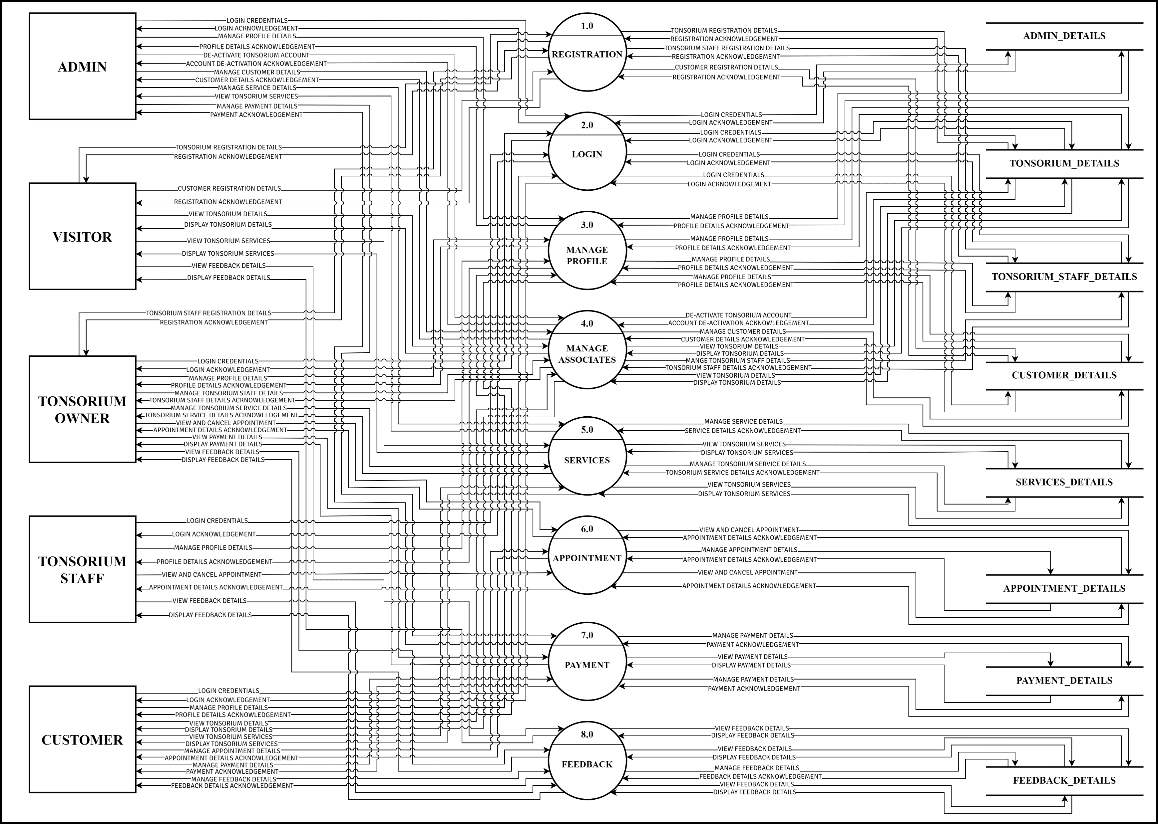

Slide 27
LEVEL 2

Slide 28
LEVEL 2
PROCESS 2.0
LOGIN

Slide 29
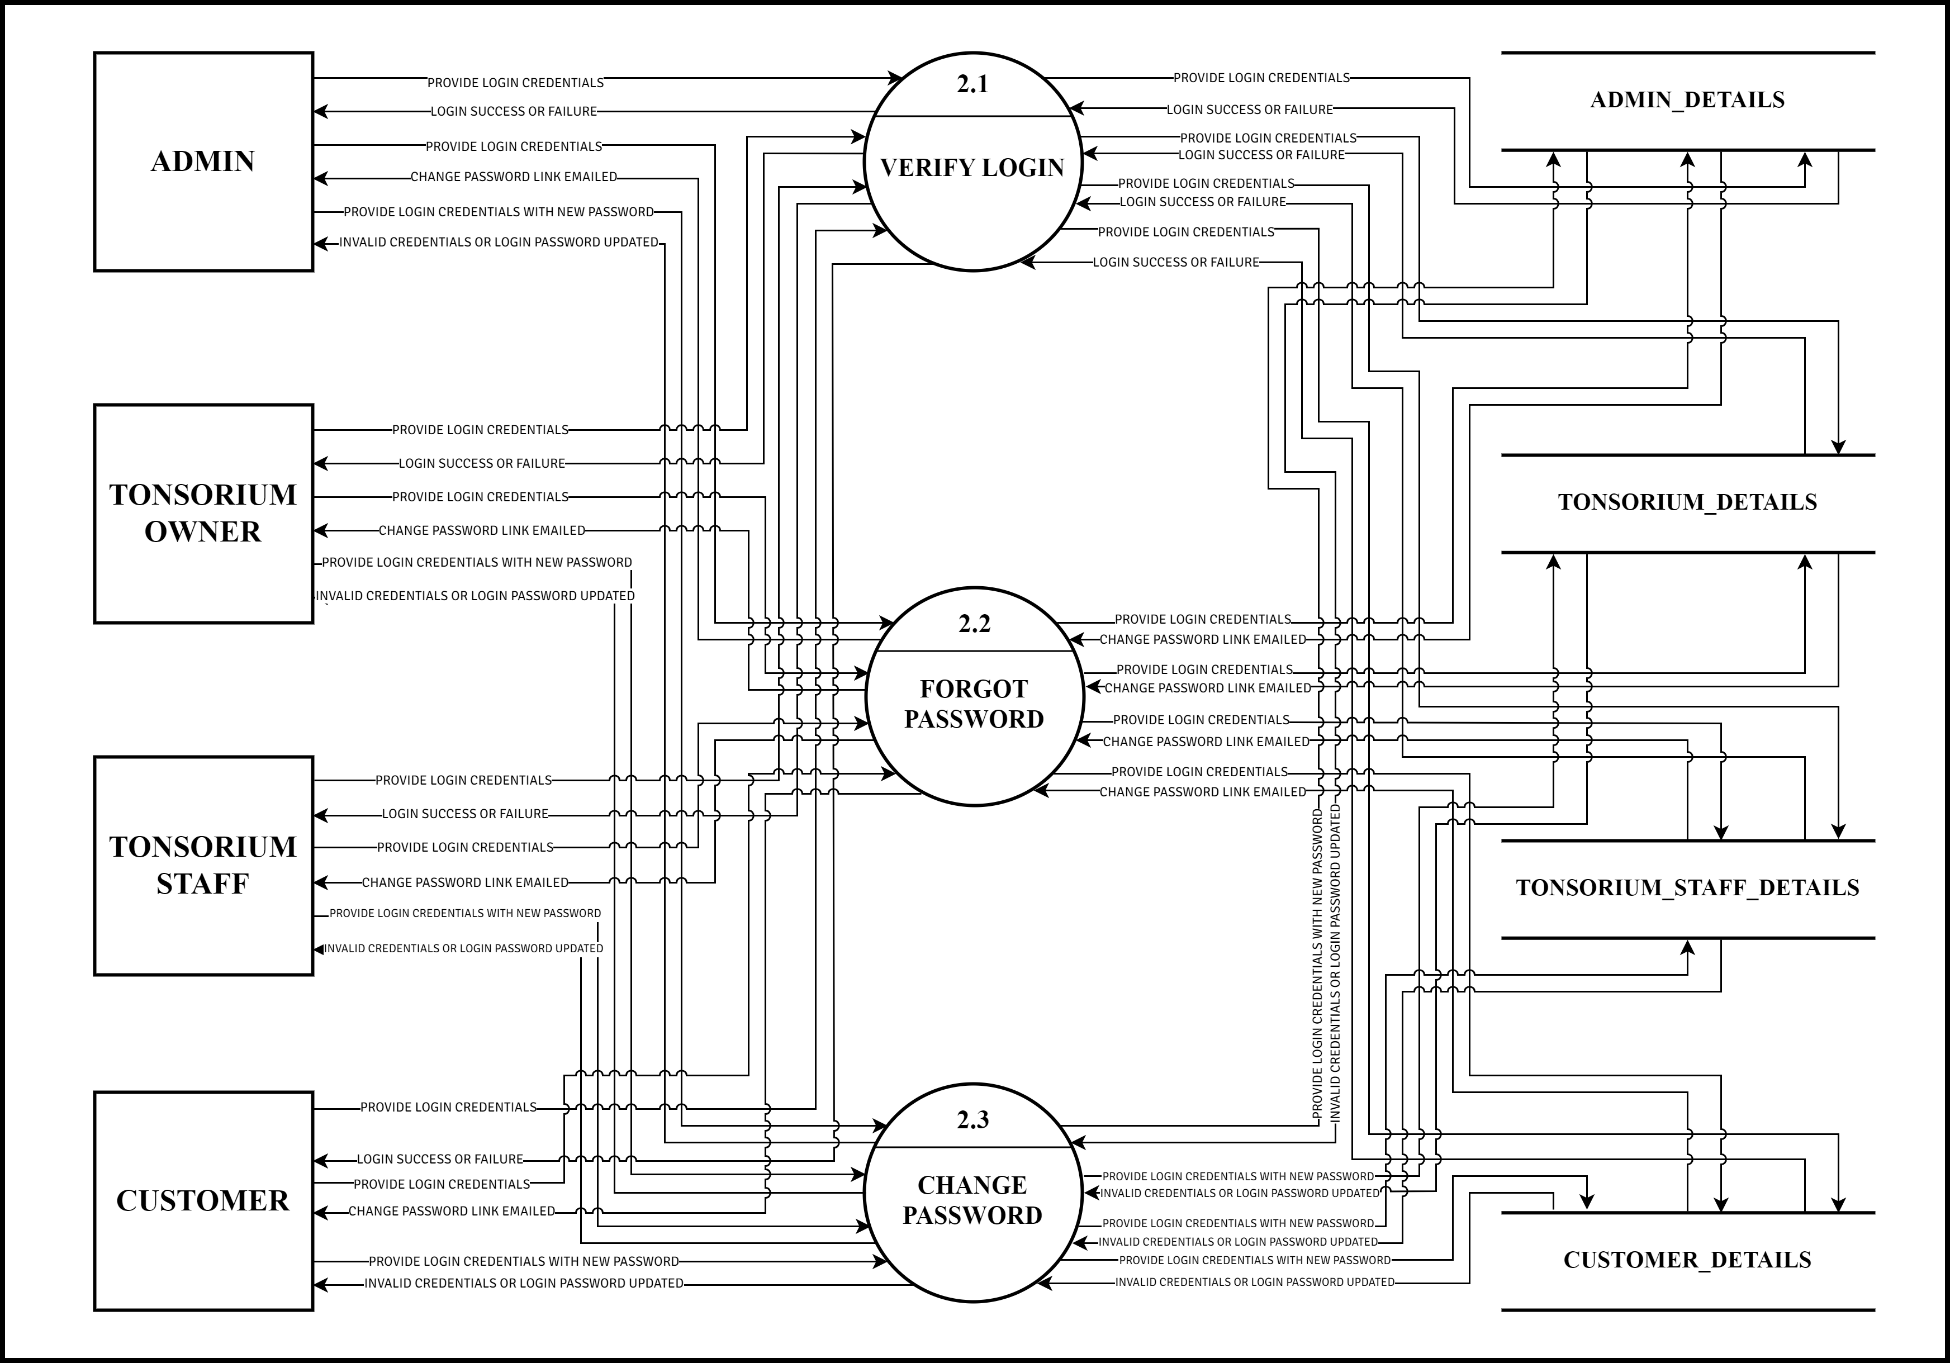

Slide 30
LEVEL 2
PROCESS 3.0
MANAGE PROFILE

Slide 31
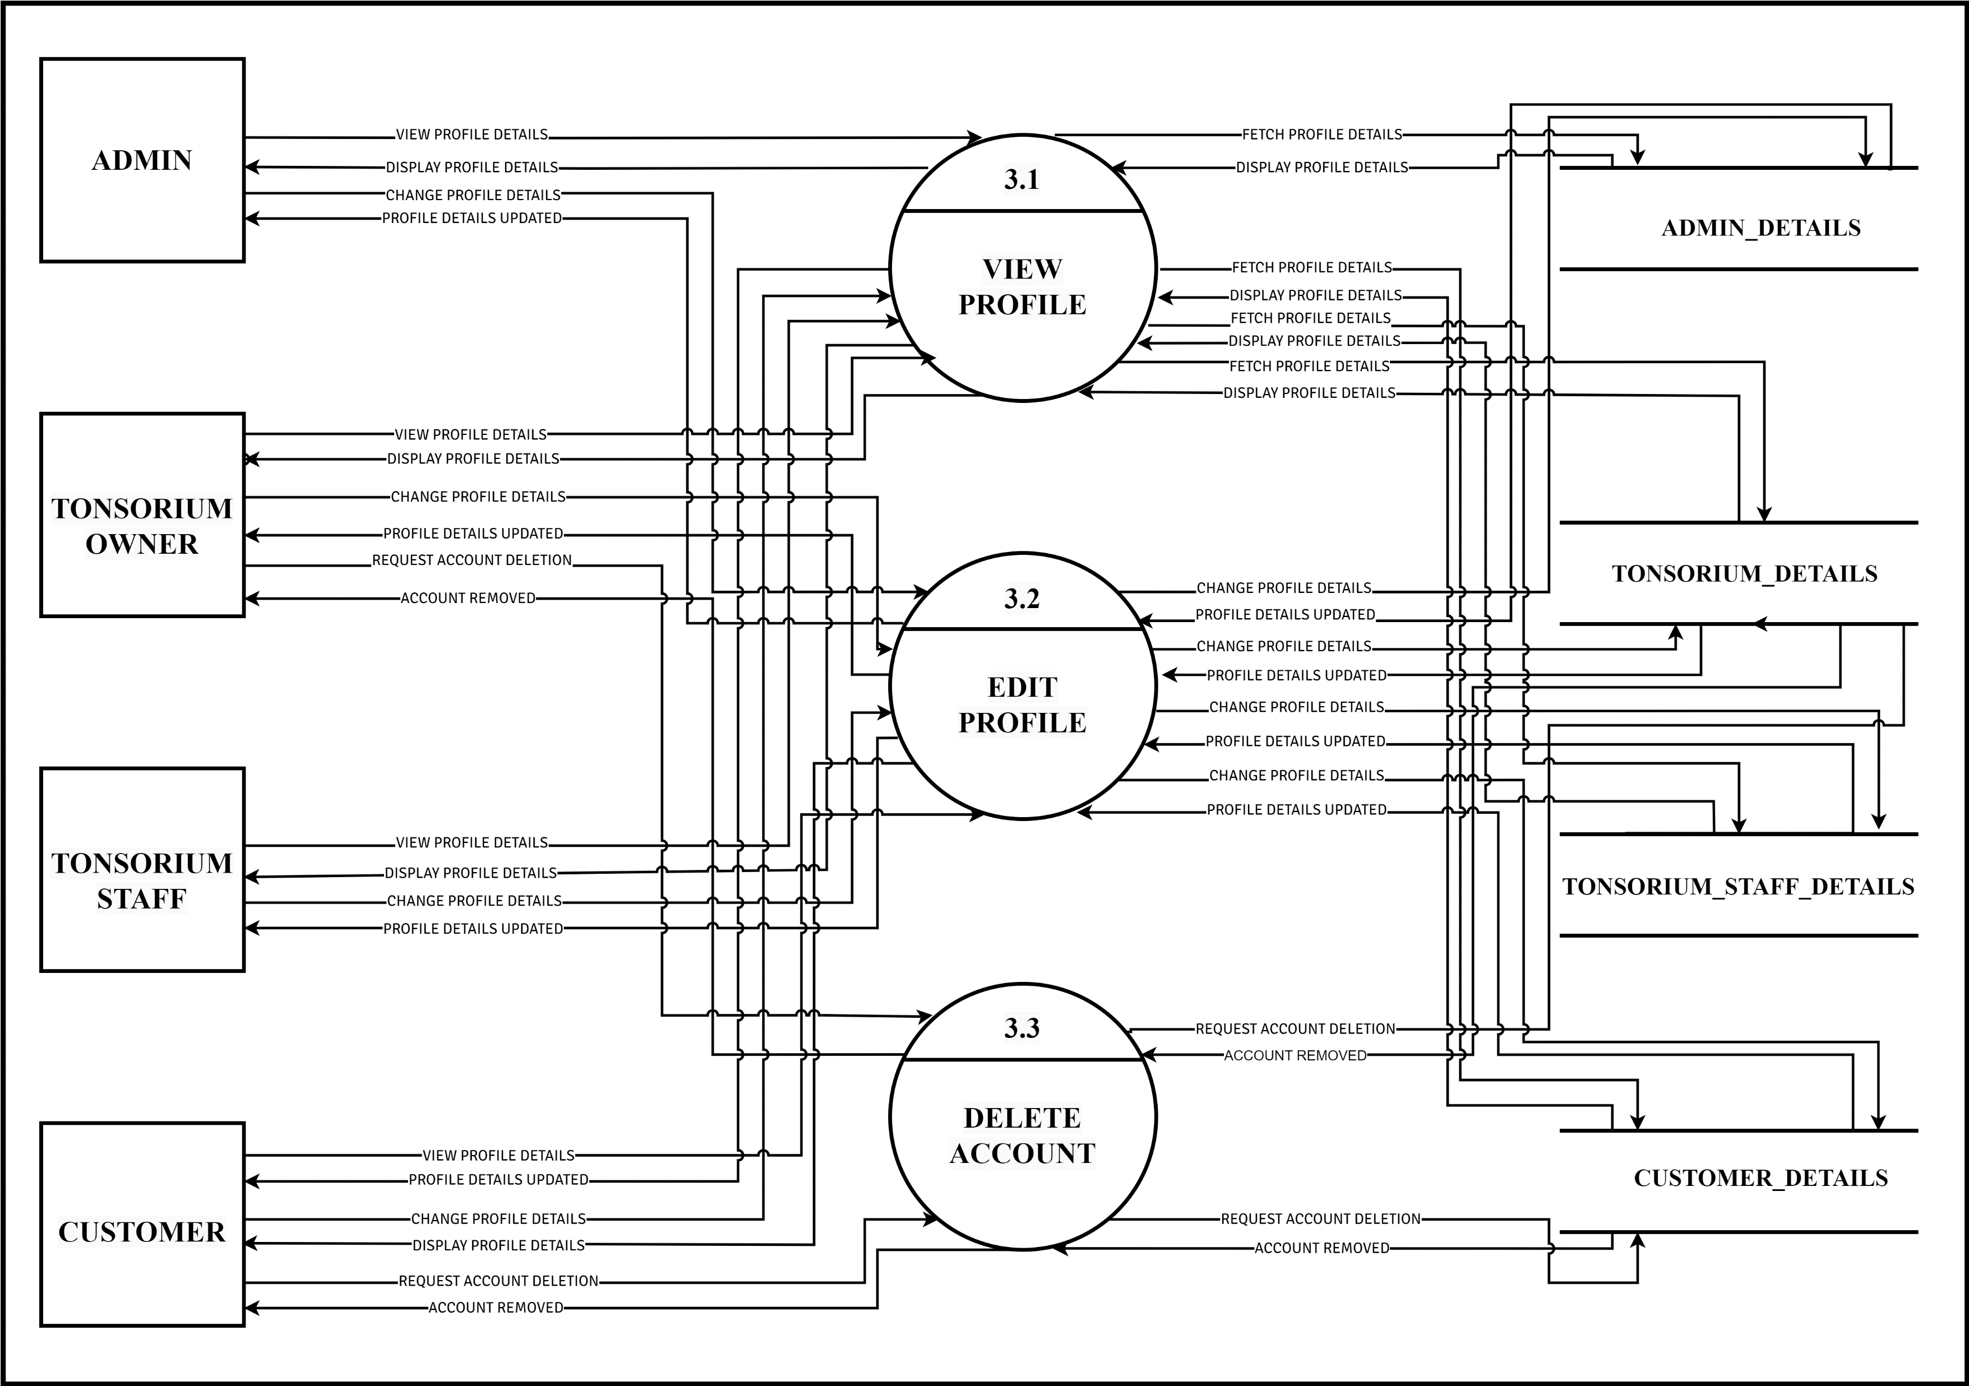

Slide 32
LEVEL 2
PROCESS 4.0
MANAGE ASSOCIATE

Slide 33
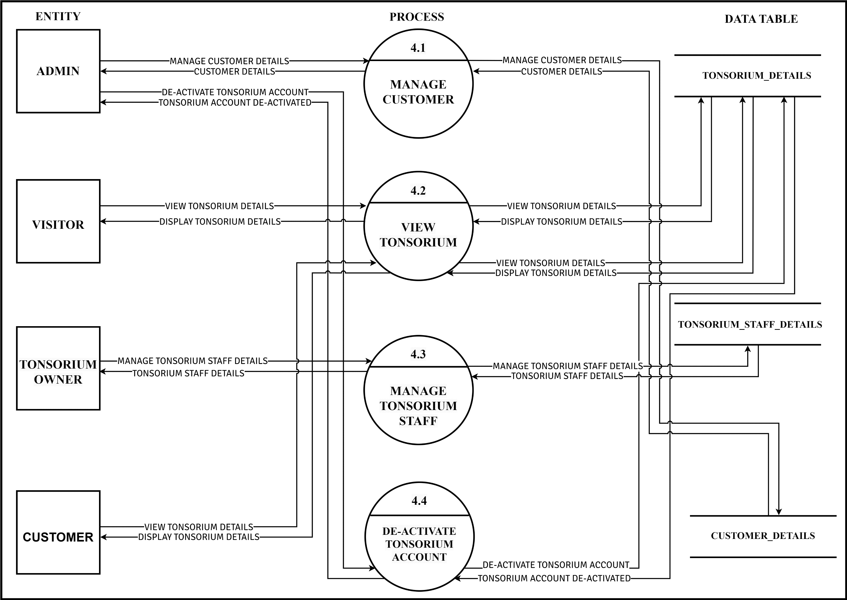

Slide 34
LEVEL 2
PROCESS 5.0
SERVICES

Slide 35
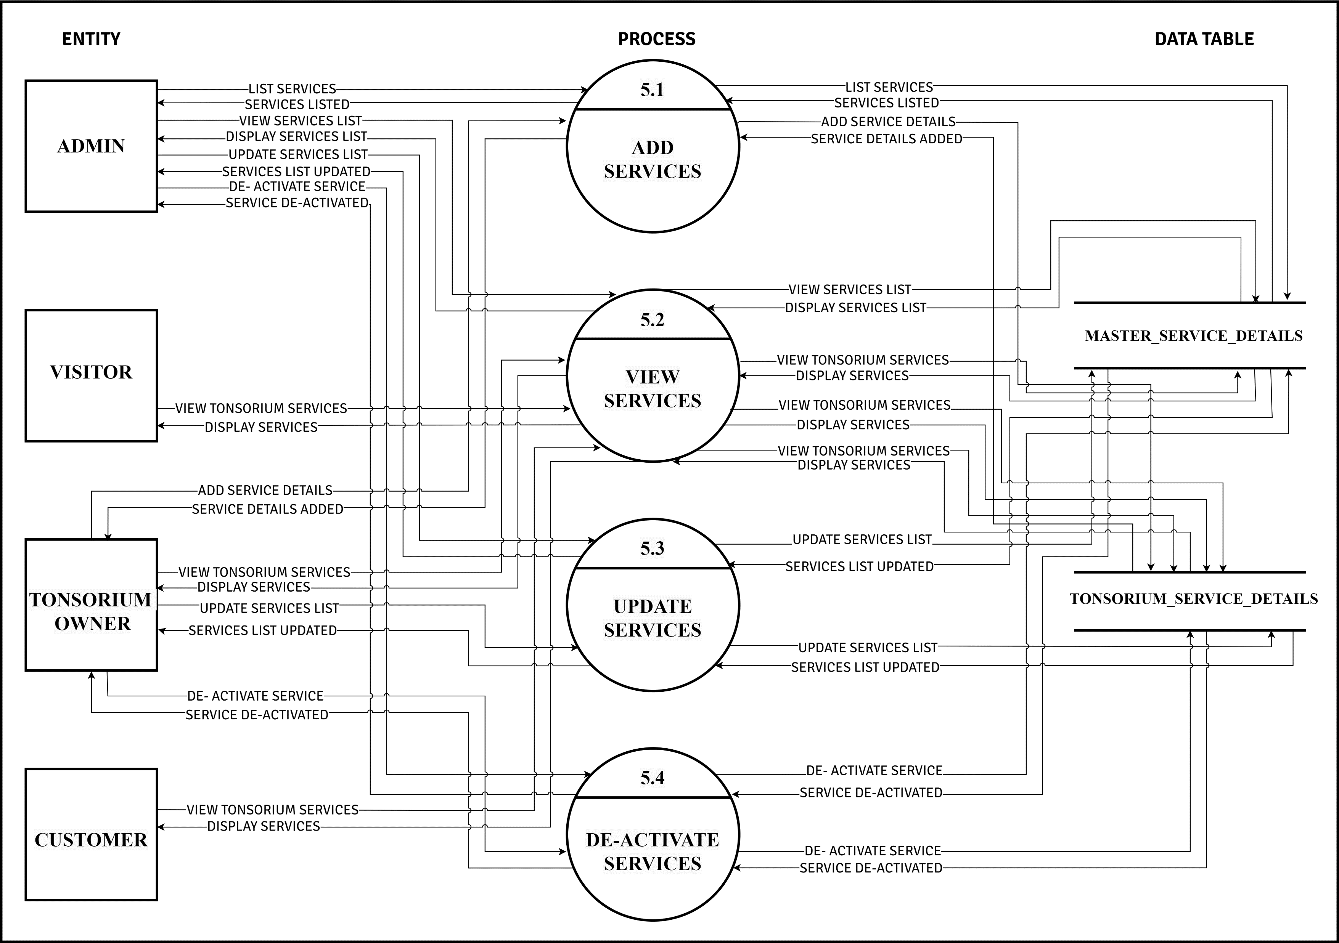

Slide 36
LEVEL 2
PROCESS 6.0
APPOINTMENT

Slide 37
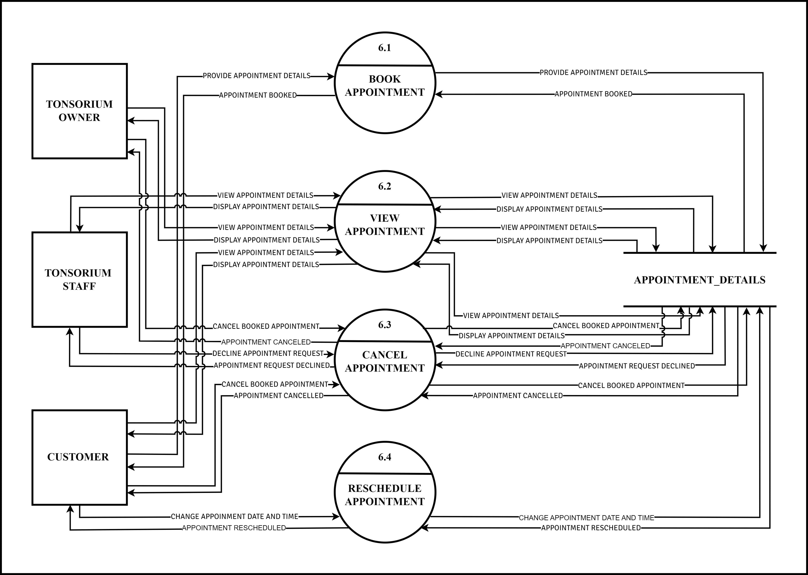

Slide 38
LEVEL 2
PROCESS 7.0
PAYMENT

Slide 39
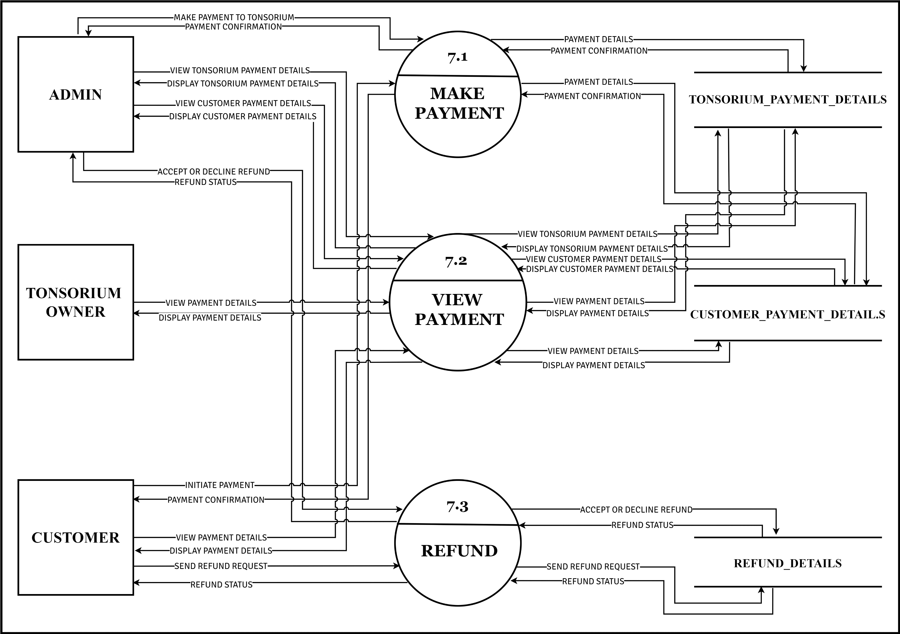

Slide 40
LEVEL 2
PROCESS 8.0
FEEDBACK

Slide 41
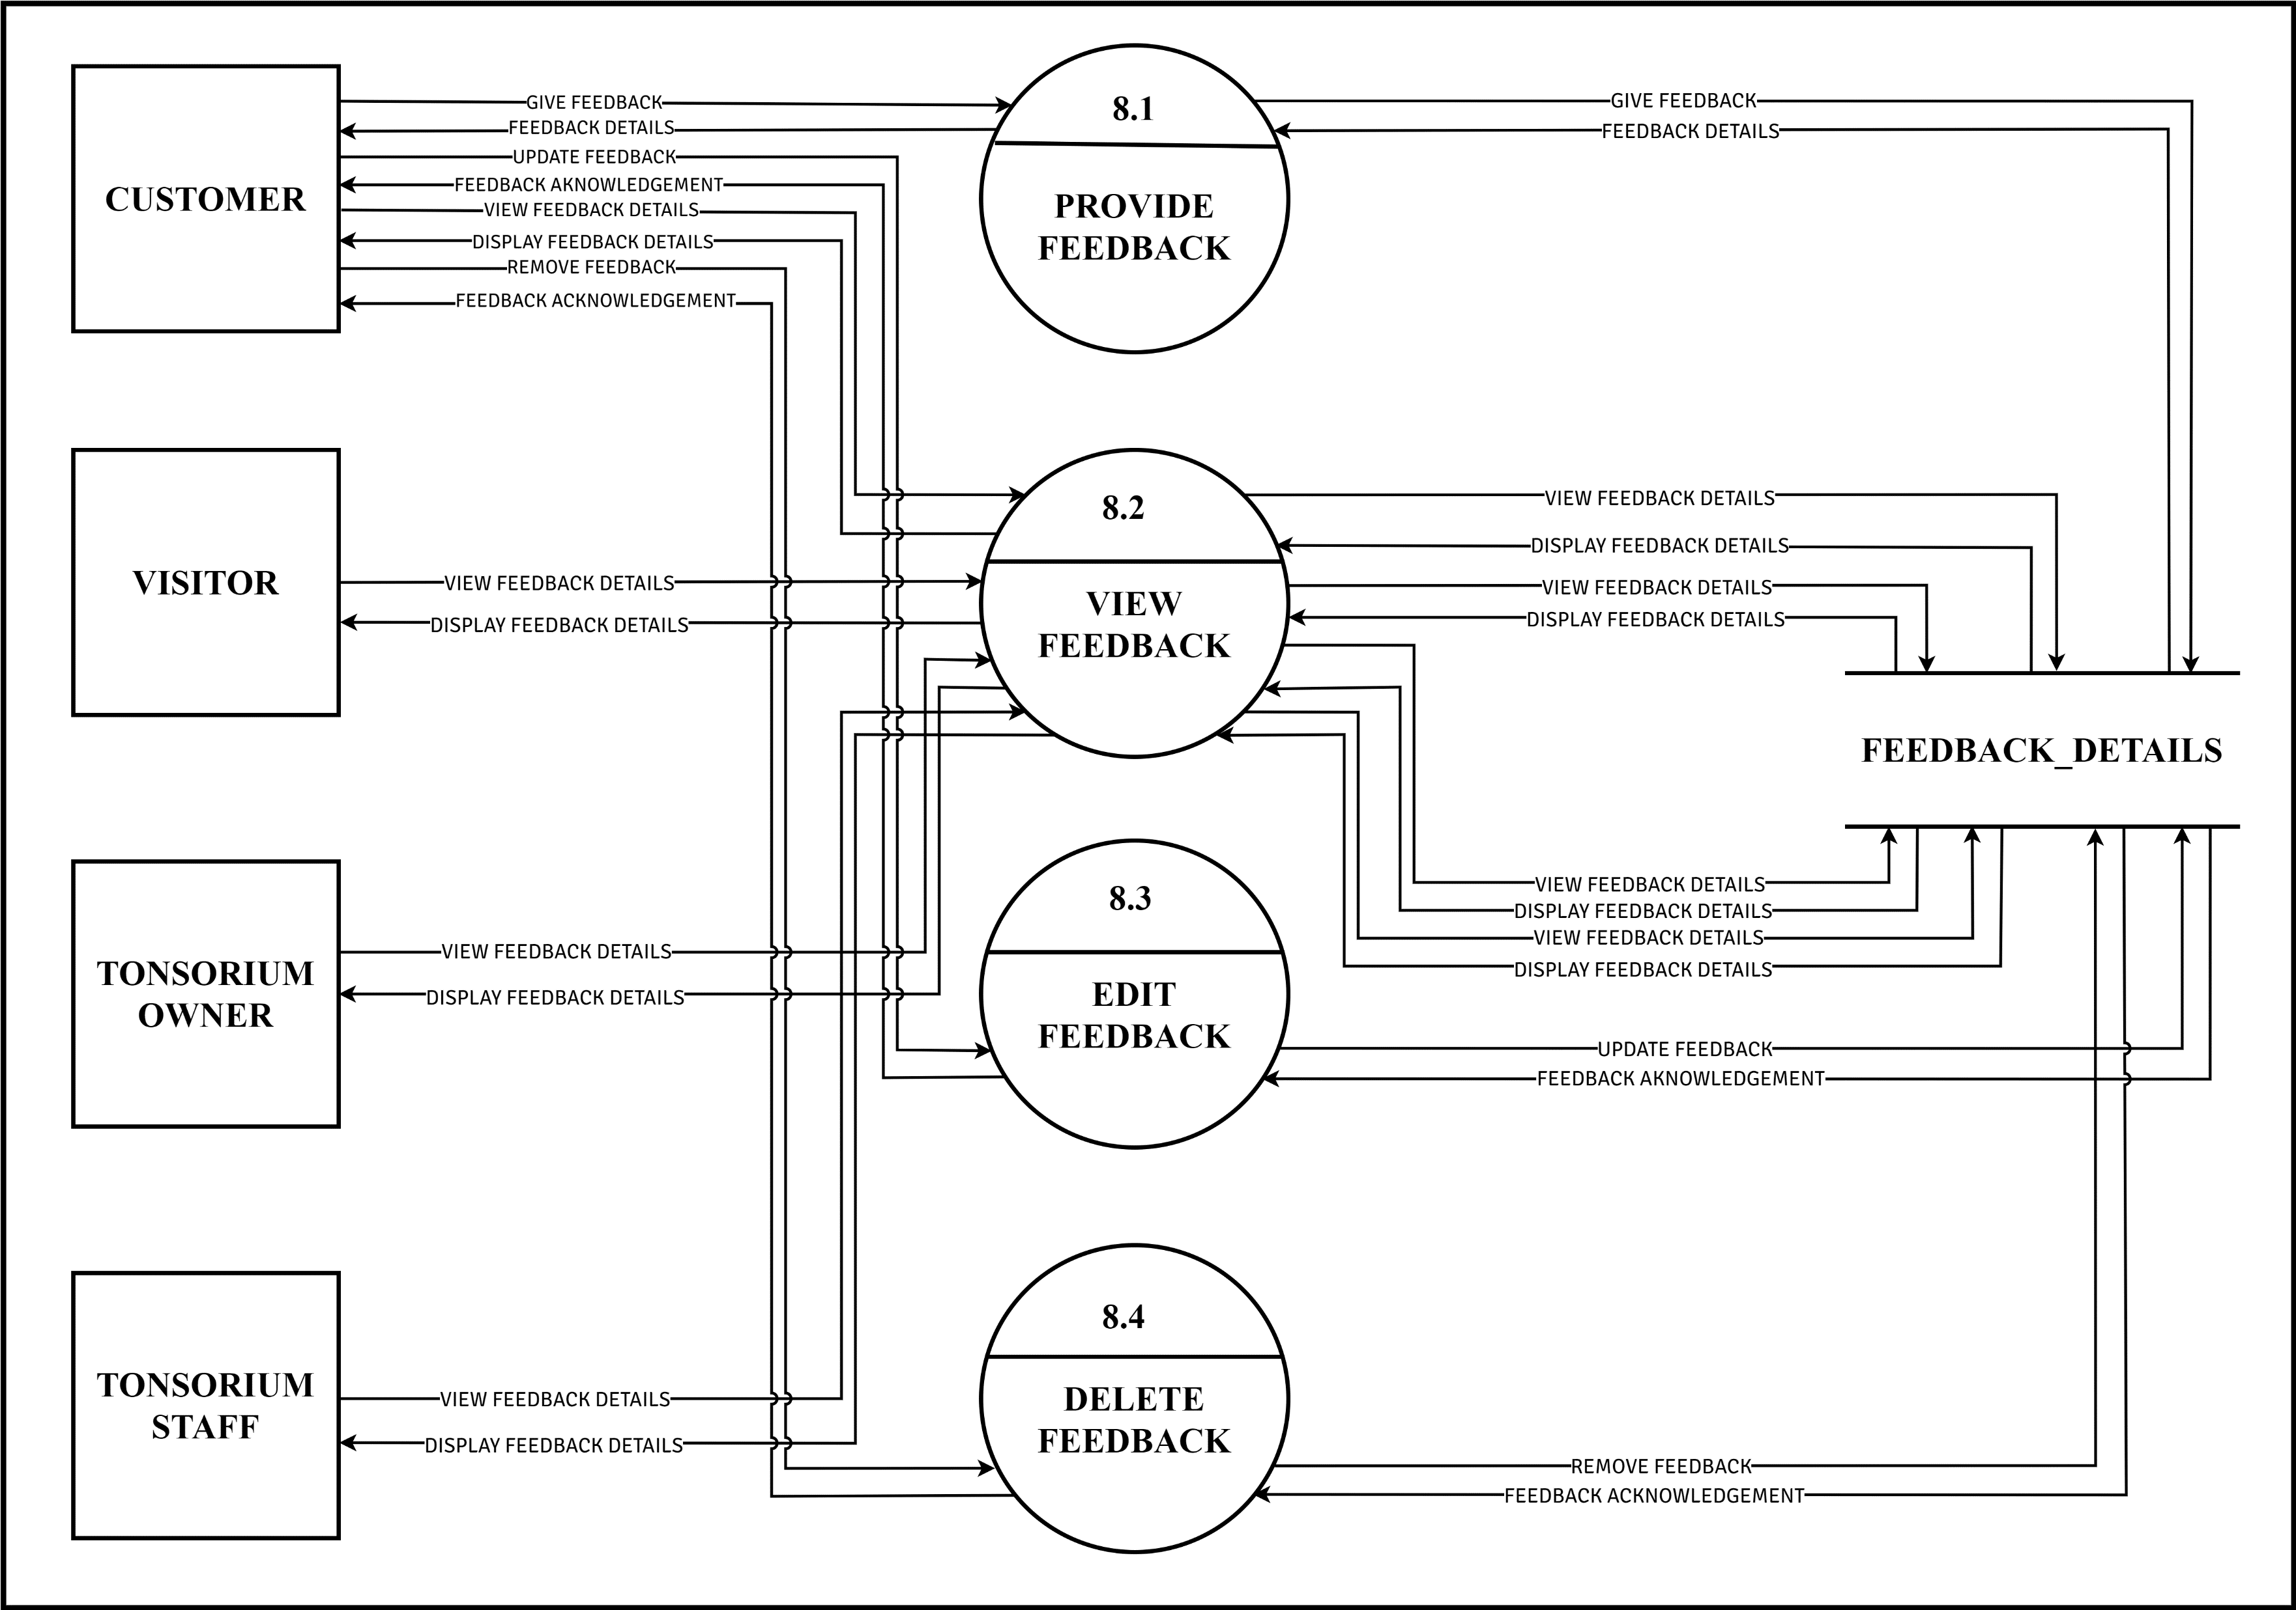

Slide 42
PROCESS 3.0
MANAGE ASSOCIATE
LEVEL 3

Slide 43
LEVEL 3
PROCESS 4.1
MANAGE CUSTOMER

Slide 44
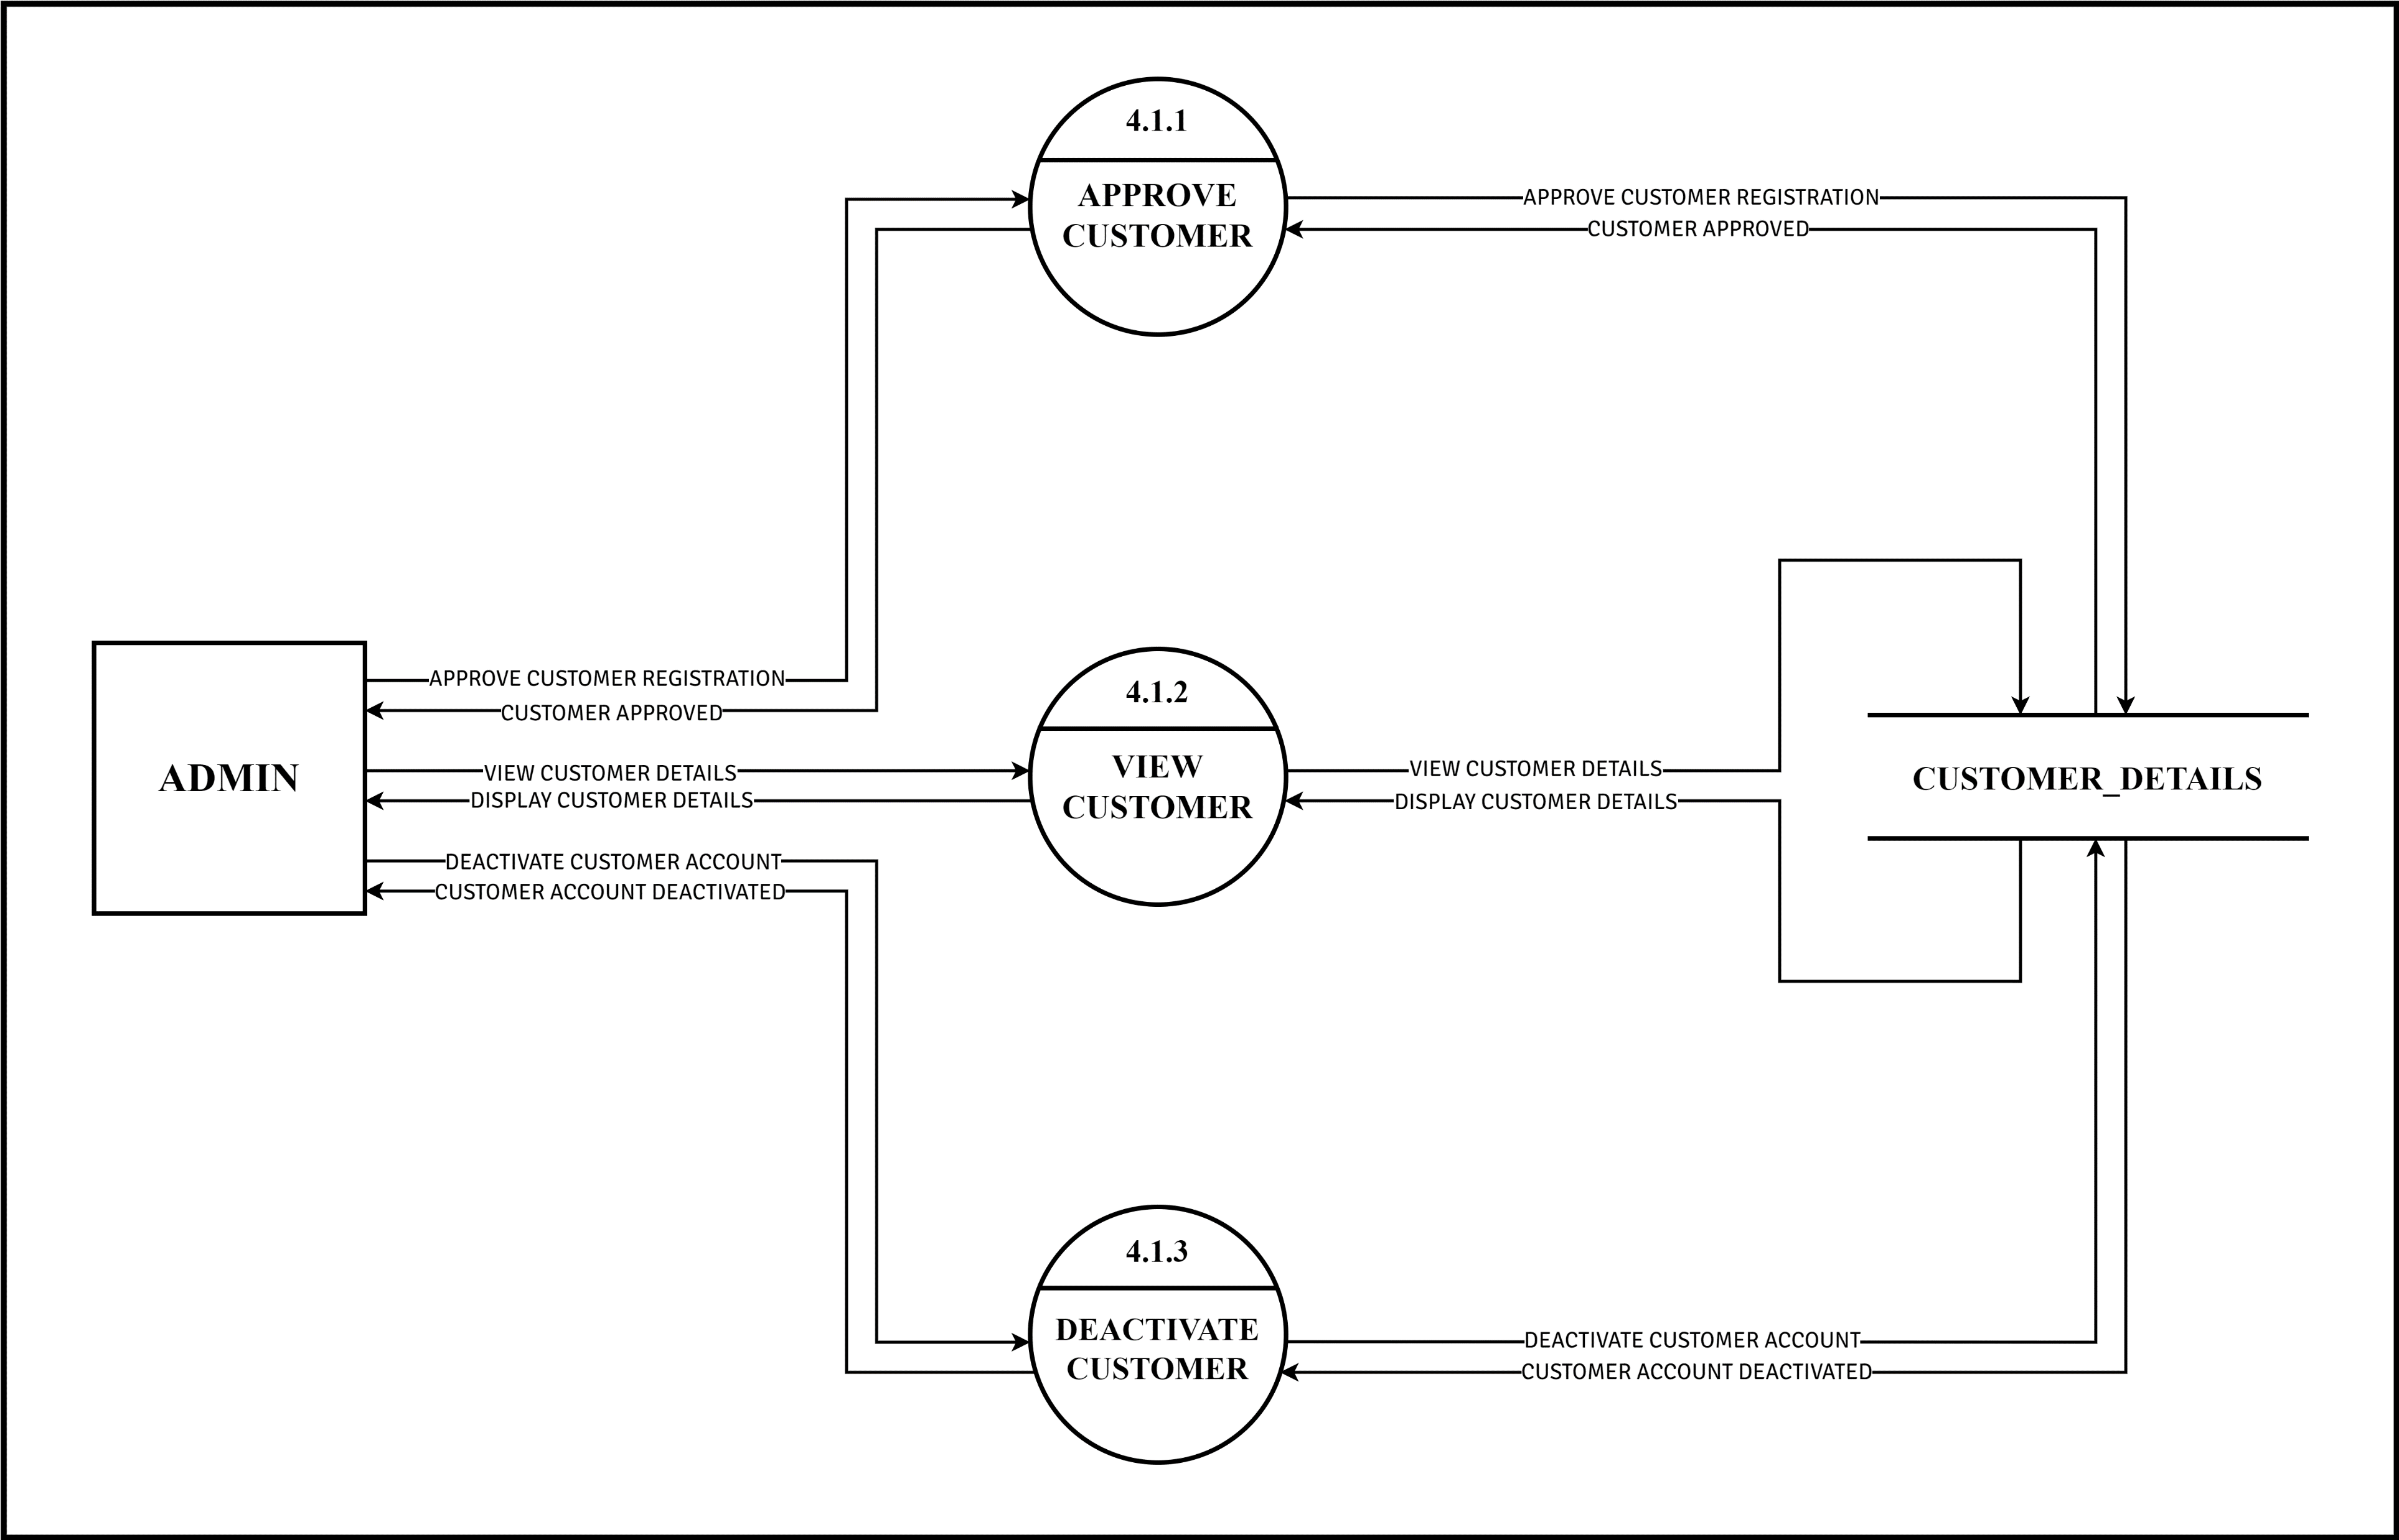

Slide 45
LEVEL 3
PROCESS 4.3
MANAGE TONSORIUM STAFF

Slide 46
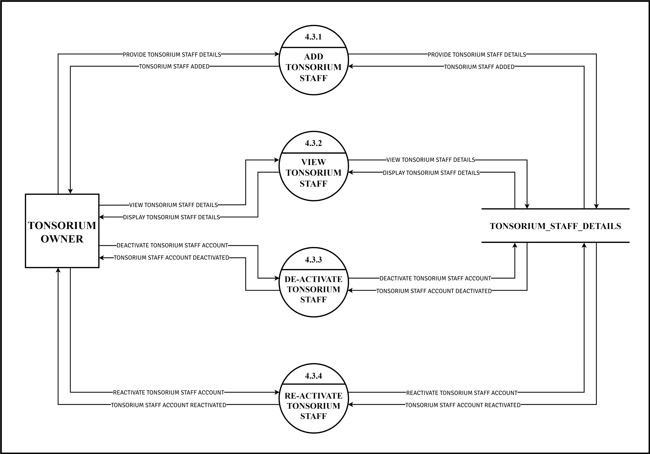

Slide 47
DATA
DICTIONARY

Slide 48
1) | ADMIN_DETAILS TABLE
2) | TONSORIUM_DETAILS TABLE
3) | TONSORIUM_STAFF_DETAILS TABLE
4) | CUSTOMER_DETAILS TABLE
5) | SERVICE_DETAILS TABLE
 | 5.1) | MASTER_SERVICE_DETAILS TABLE
 | 5.2) | TONSORIUM_SERVICE_DETAILS TABLE
6) | APPOINTMENT_DETAILS TABLE
7) | PAYMENT_DETAILS_TABLE
 | 7.1) | CUSTOMER_PAYMENT TABLE
 | 7.2) | TONSORIUM_PAYMENT TABLE
 | 7.3) | REFUND_DETAILS TABLE
8) | FEEDBACK_DETAILS TABLE
9) | STATE_DETAILS TABLE
10) | CITY_DETAILS TABLE
LIST
OF
TABLES

Slide 49
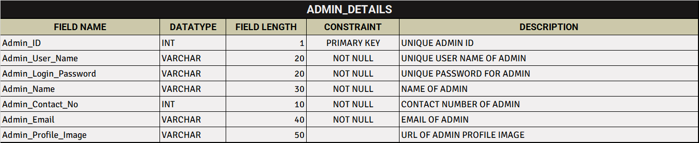
ADMIN DETAILS TABLE

Slide 50
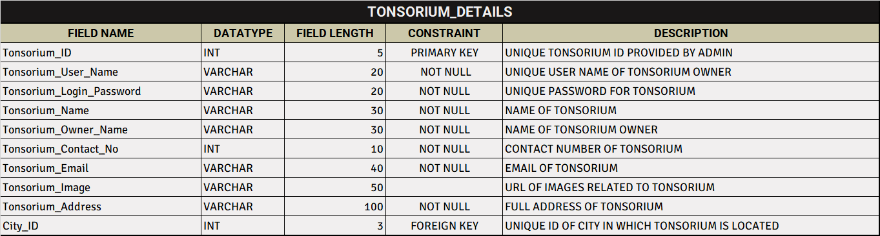
TONSORIUM DETAILS TABLE

Slide 51
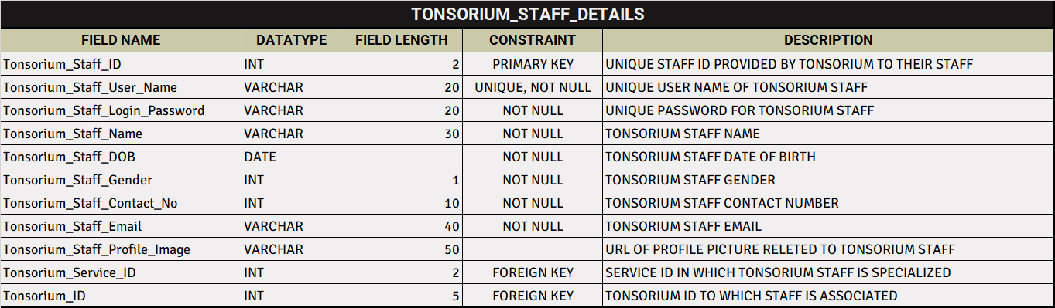
TONSORIUM STAFF DETAILS TABLE

Slide 52
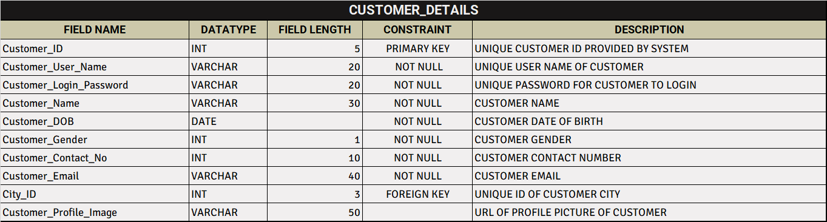
CUSTOMER DETAILS TABLE

Slide 53
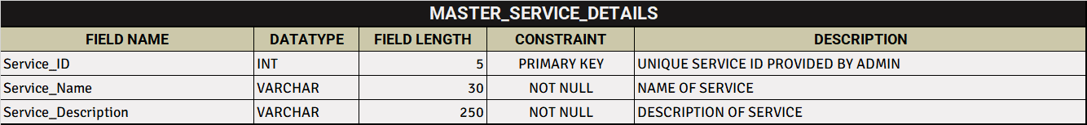
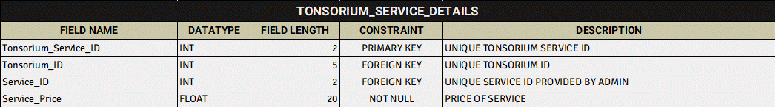
SERVICE DETAILS TABLES

Slide 54
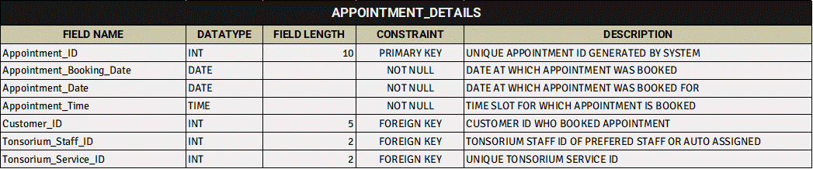
APPOINTMENT DETAILS TABLE

Slide 55
PAYMENT DETAILS
SUB-TABLES :
CUSTOMER PAYMENT DETAILS TABLE
TONSORIUM PAYMENT DETAILS TABLE
REFUND DETAILS TABLE

Slide 56
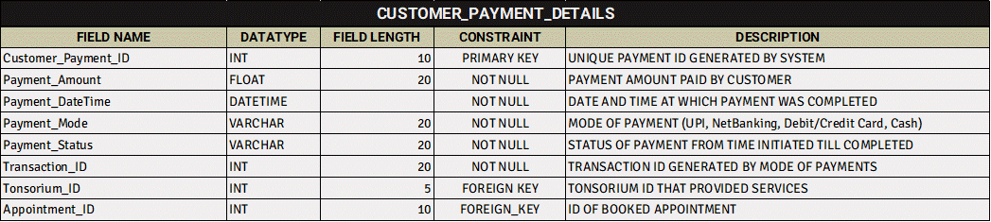
CUSTOMER PAYMENT DETAILS TABLE

Slide 57
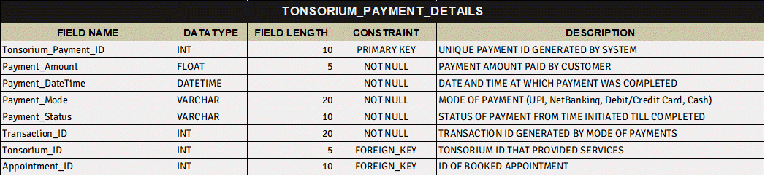
TONSORIUM PAYMENT DETAILS TABLE

Slide 58
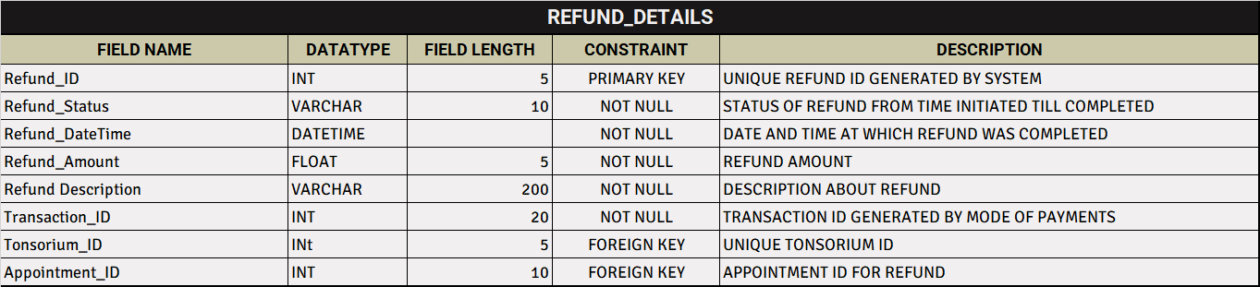
REFUND DETAILS TABLE

Slide 59
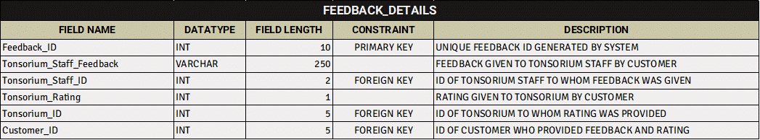
FEEDBACK DETAILS TABLE

Slide 60
STATE AND CITY DETAILS TABLE

Slide 61

ENTITY-RELATIONSHIP DIAGRAM

Slide 62
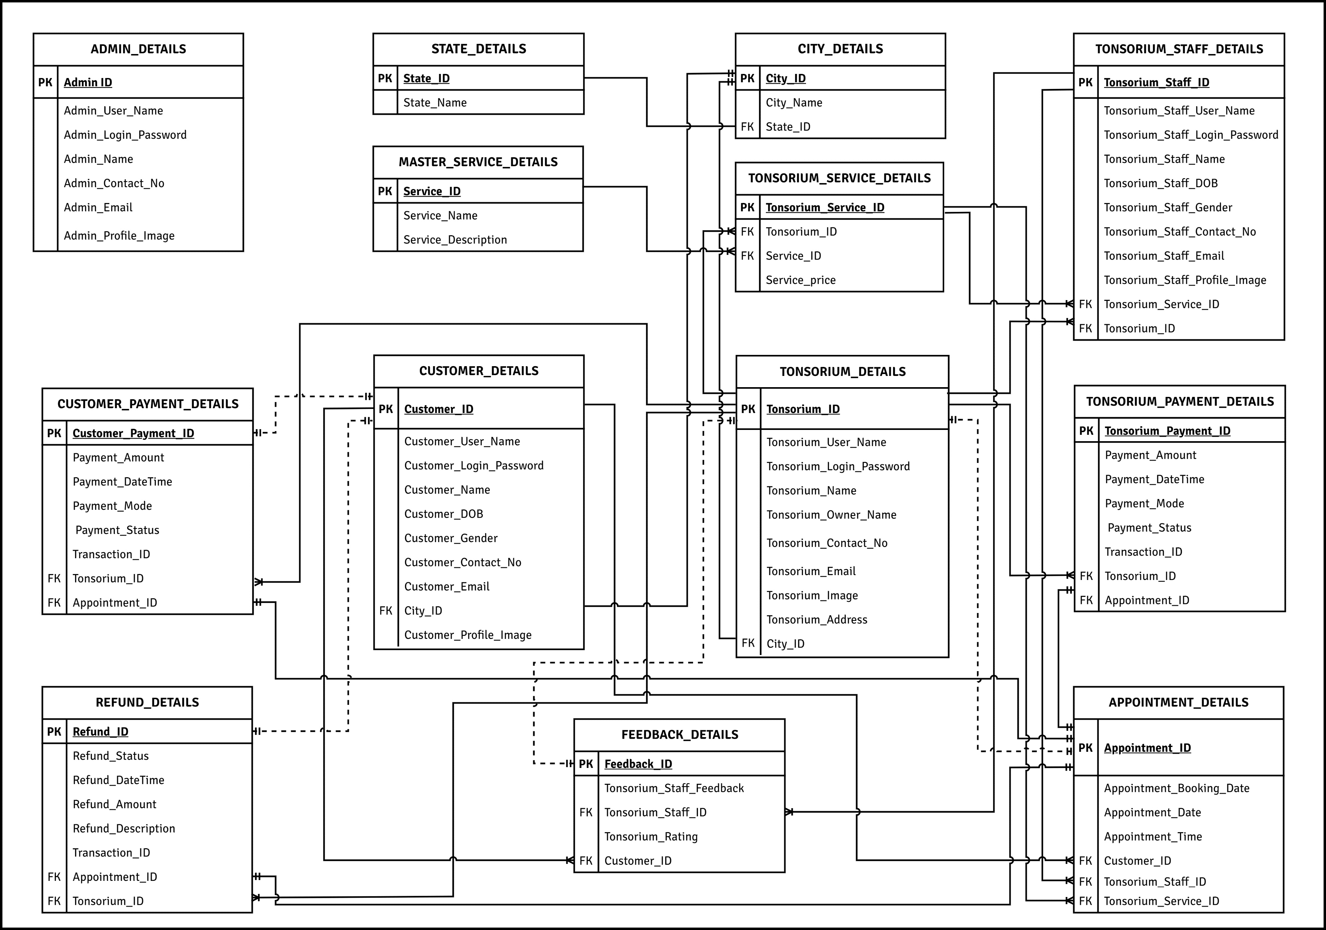

Slide 63

THANK YOU

